Slide 1
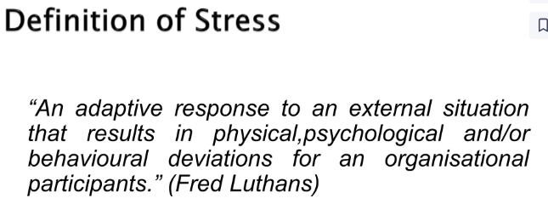
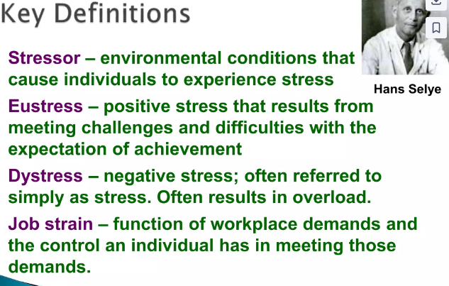
Stress

Slide 2
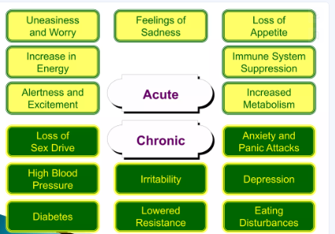

Slide 3
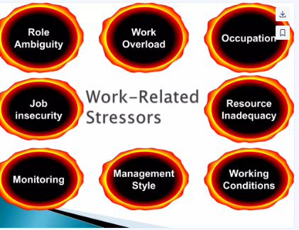

Slide 4
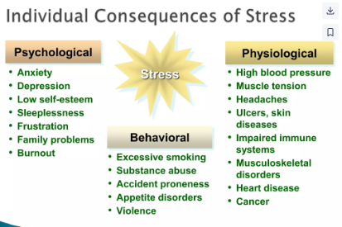

Slide 5
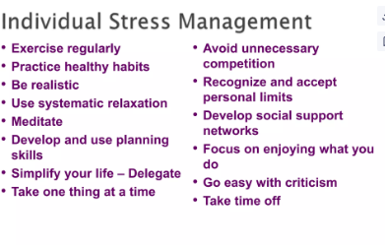
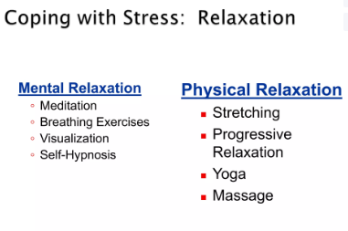
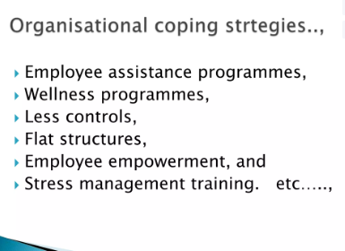

Slide 7
Organisational Behaviour
Topic: Lecture 30 Socialisation
Dr. C. Vijaya Banu
Professor , School of Management
SASTRA Deemed University, Thanjavur – 613 401
vijayabanu@mba.sastra.edu

Slide 8
Socialization
Socialization is the process of working together, of developing group responsibility.
socialization is the process by which the individual learns to conform to the norms of the group
Socialization is a social process through which an individual develops his own self by learning the norms and by knowing about his own self from others.

Slide 9
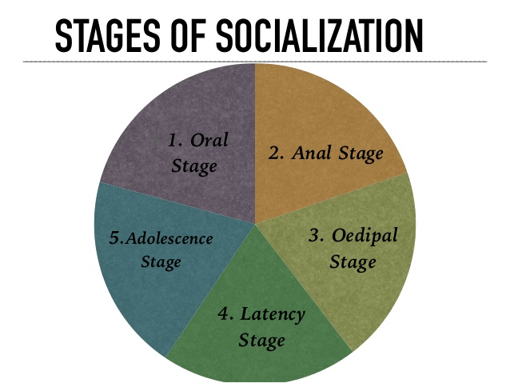
Primary Socialisation

Slide 10
AGENCIES of SOCIALIZATION
FAMILY
SCHOOL
PEER- GROUP
MASS- MEDIA

Slide 11
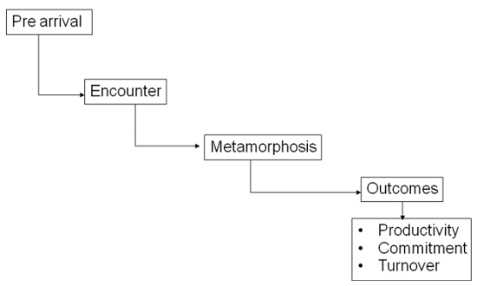
Socialisation-stages

Slide 13
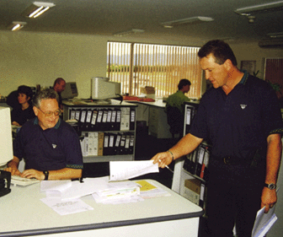
Organisational culture defined
The basic pattern of shared assumptions, values and beliefs considered to be the correct way of thinking about and acting on problems and opportunities facing the organisation.
Courtesy of Melso Minerals (Matamata) Ltd

Slide 14
Elements of organisational culture

Slide 15
Elements of Organizational Culture

Slide 17
Organizational Culture
Enable Functions
Liabilities
Controlling behavior
Defining boundaries
Conveying identity
Promoting commitment
Blocking mergers
Inhibiting diversity
Inhibiting change
Blocking acquisitions

Slide 18

What Is Organizational Culture?
Organizational Culture
A common perception held by the organization’s members; a system of shared meaning.
The basic pattern of shared values and assumptions governing the way employees within an organization think about and act on problems and opportunities.
Characteristics:
Innovation and risk taking
Attention to detail
Outcome orientation
People orientation
Team orientation
Aggressiveness
Stability

Slide 19
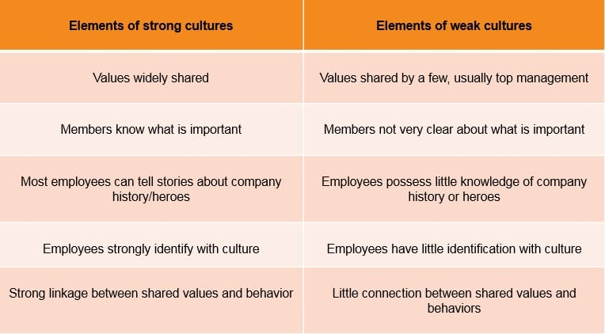

Slide 21
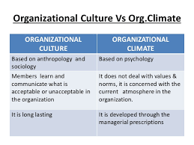

Slide 22
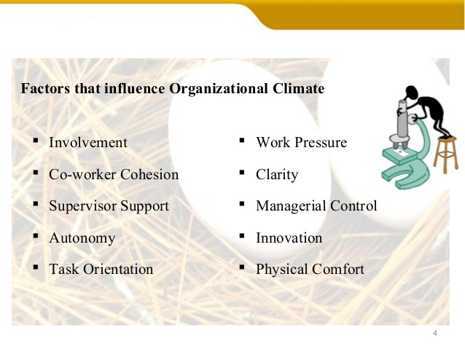

Slide 26
THE ORAL STAGE
➤ It is a stage which begins from birth till child is of 1 year.
➤ It needs to be fed as it is helpless and dependent on others for its very survival.
➤ It also needs to be protected from the cold, damp and other discomforts.
➤ During this stage, the child cries for everything as this is the only way it can communicate its needs.
➤ The aim of oral stage is to establish oral dependency.

Slide 27
THE ORAL STAGE
➤ During the ﬁrst year of its life, the child’s contact with the outside world is through the mouth and lips.
➤ Mother generally starts the process of socialization as the child is dependent on her for its substance.
➤ The child is only concerned with its oral needs.
➤ Freud called this stage as stage of ‘primary identiﬁcation’.
➤ It means that the child merges its identity with that of the mother.
➤ Crying and smiling are forms of early social behaviour.

Slide 28
THE ANAL STAGE
➤ During this stage the child learns that one cannot totally depend on the mother for everything.
➤ The child realizes that there are some things that it must do by itself.
➤ The child undergoes toilet training, acquires other skills.
➤ The child internalizes two separate roles, one’s own and that of the mother.
➤ It is taught to distinguish between wrong and right actions through a system of reward and punishments.

Slide 29
THE OEDIPAL STAGE
➤ It is at this stage that the child becomes a member of the family as a whole.
➤ the child learns to identify itself with the social role ascribed to it on basis of its gender.
➤ According to Freud, the boy develops the ‘Oedipus Complex’ and girl develops ‘Electra Complex’.
➤ In this stage there is a lot of pressure on the child to identify with the right gender.
➤ Boys generally identify with the father and girls their mother.

Slide 30
THE LATENCY STAGE
➤By the beginning of this stage, the child has learnt to be independent in the daily routine at home.
➤He/she learns social norms.
➤This stage has been called ‘gang stage’ by some sociologists.
➤There is greater participation in group activities and group loyalties are considered important.
➤There is greater revolt against adult authority and domination.

Slide 31
ADOLESCENCE STAGE
➤ This stage starts with the onset of puberty & continues through the teenage years.
➤ This is a stage of transition from childhood to maturity during which new patterns of behaviour are learnt to meet the increased demands of the peer group & of adult society.
➤ The adolescent undergoes a number of physiological changes.
➤ Boys & girls try to break free from parental control.

Slide 32
ADOLESCENCE STAGE
➤ Adolescents are generally interested in various recreational activities like T.V. , sports, dance, music, being online networking on facebook,etc.
➤ In modern societies adolescents are encouraged to make their own decisions regarding education, occupation & their marriage partners.
➤ They are also expected to accept greater responsibilities.

Slide 33
Secondary socialization anticipatory socialization
In anticipatory socialization the individual mimic or copy the behavior of his anticipated future role. For example- if one has anticipated his/her future role as a doctor he/she will start picking up doctor’s mannerism.

Slide 34
RE-SOCIALIZATION
Re-socialization is a kind of learning which involves the learning of new ways of thinking, feeling and behaving that are completely different from one’s previous way of life.

Slide 35
REVERSE-SOCIALIZATION
In reverse-socialization the younger generation transfers knowledge to the older generation. This occurs mostly in industrial societies where the pace of technological change is very rapid.

